Slide 1

NSG Pilkington – University of Liverpool Machine Learning Project: 05/05/2021
Dr. Peter Green
Diego Echeverria
Sarini Jayasinghe
Risk Institute,
School of Engineering

Slide 2
Today
PCA Plot
Reversals
Combinations
ISRA (if we have time)

Slide 3
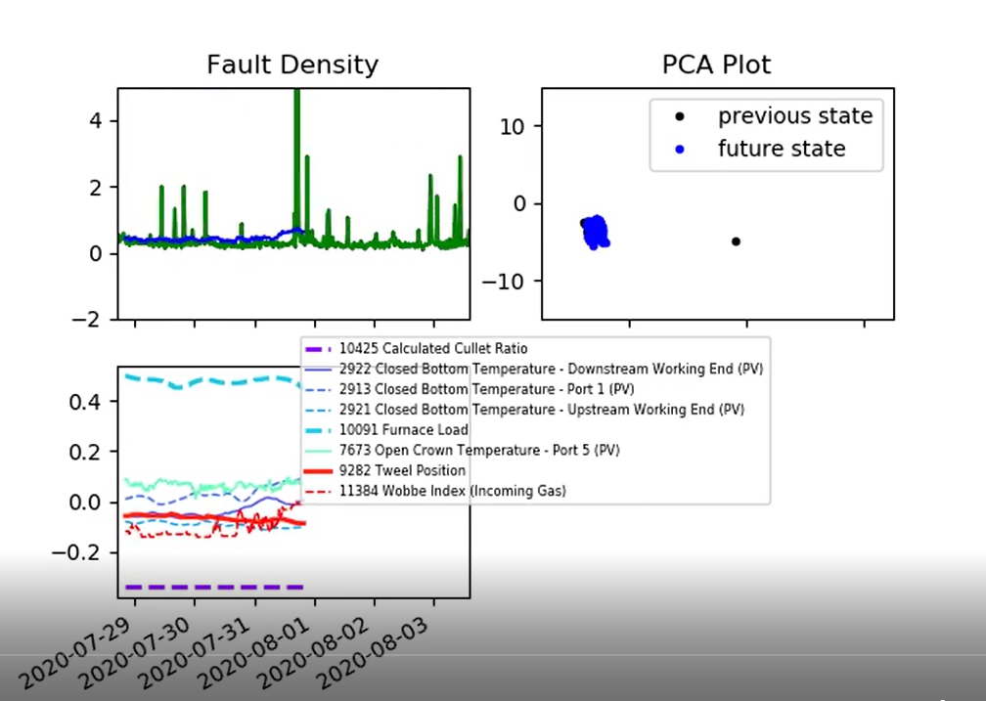
PCA Plot
PCA plot added to observe regions of model inputs

Slide 4
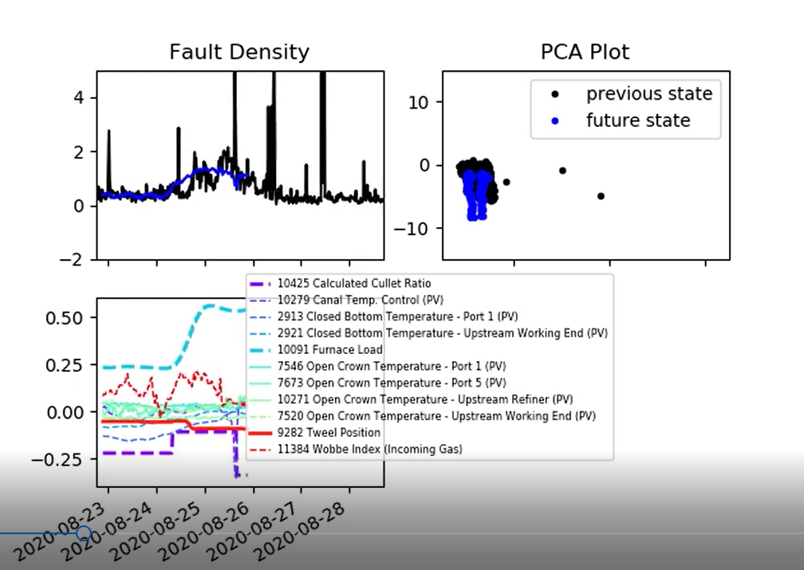
PCA Plot
PCA plot added to observe regions of model inputs
Change of region

Slide 5
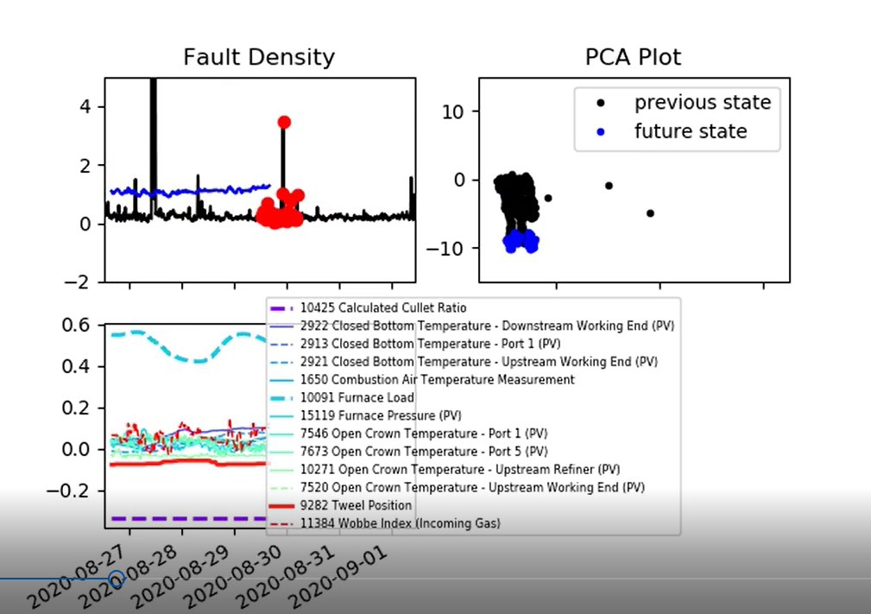
PCA Plot
PCA plot added to observe regions of model inputs

Slide 6
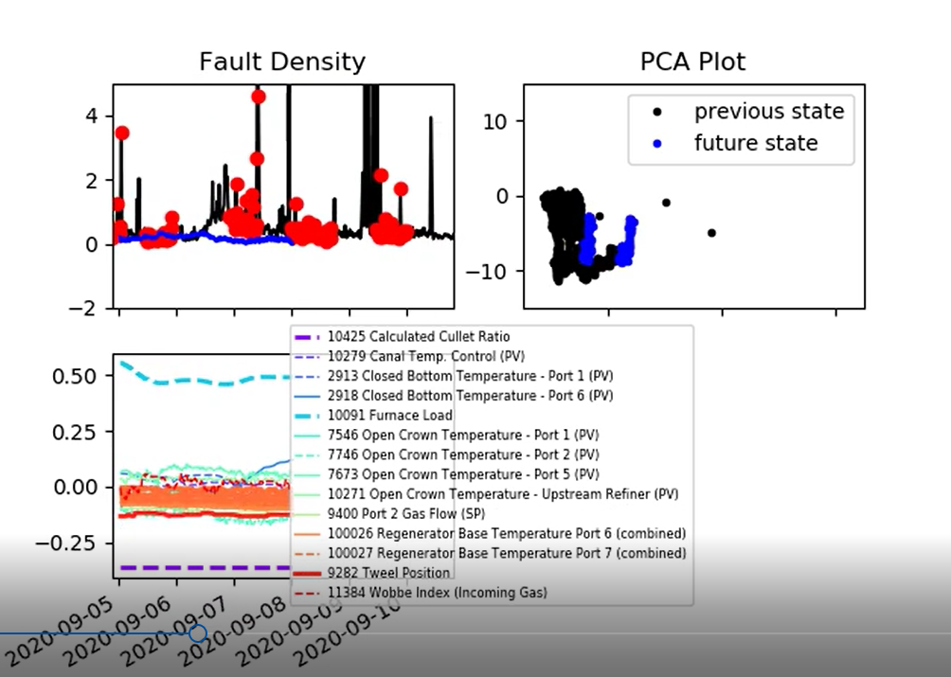
PCA Plot
PCA plot added to observe regions of model inputs
Change of region

Slide 7
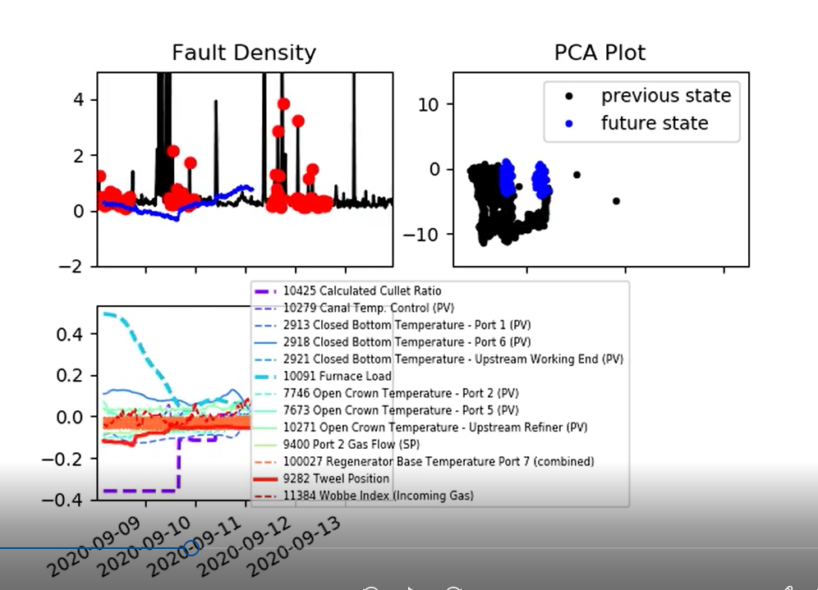
PCA Plot
PCA plot added to observe regions of model inputs

Slide 8
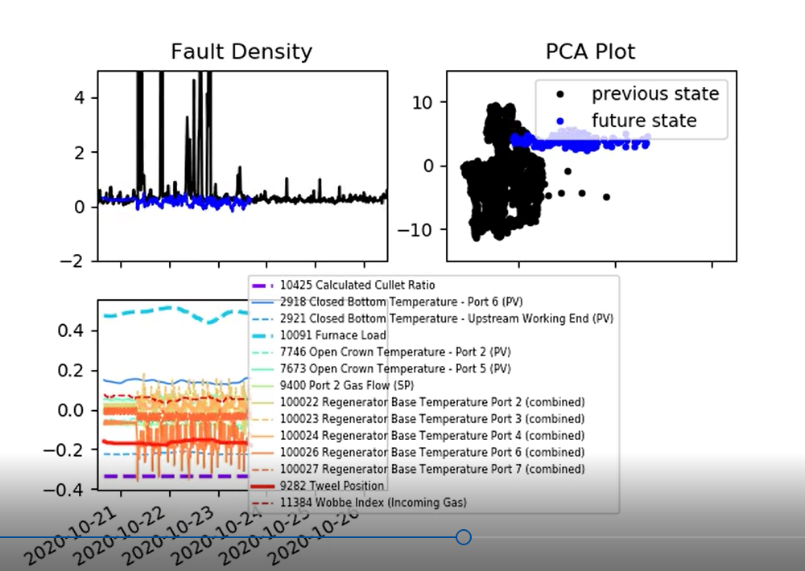
PCA Plot
PCA plot added to observe regions of model inputs

Slide 9
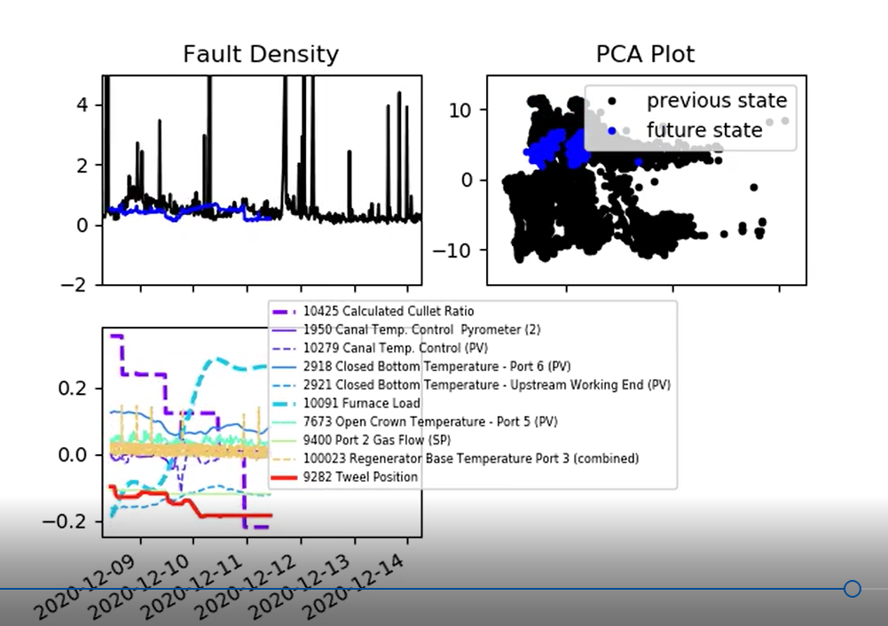
PCA Plot
PCA plot added to observe regions of model inputs

Slide 10
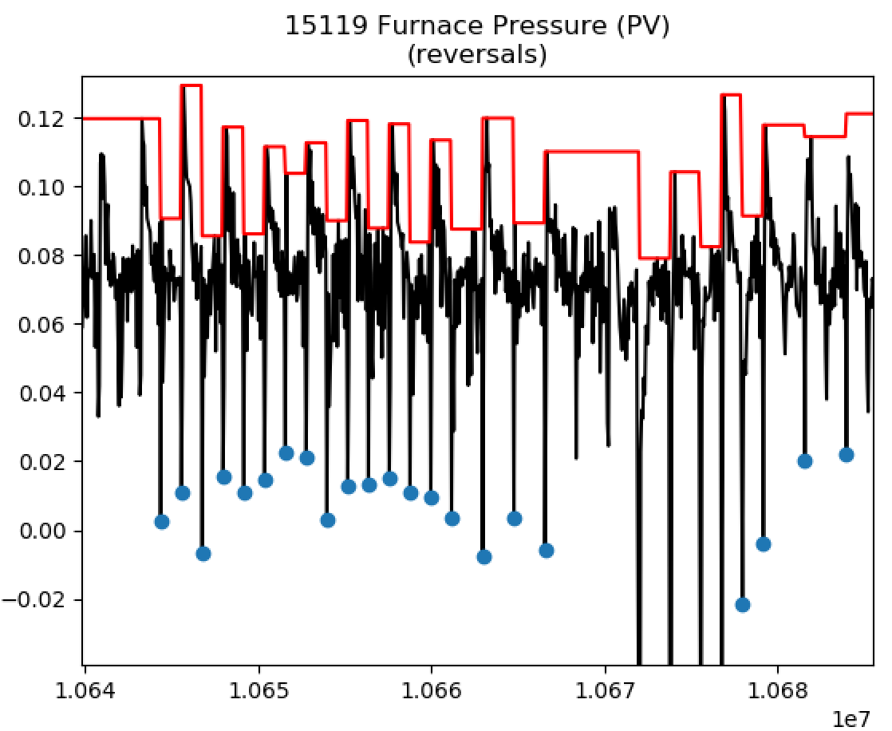
Reversals
Complicated by:
The severity of the signal ‘drops’ vary a lot.
The time difference between the drops isn’t completely consistent (though it is close).
Considering simply putting signals affected by reversals though the ‘spike removal’ block, followed by a low pass filter block.

Slide 11
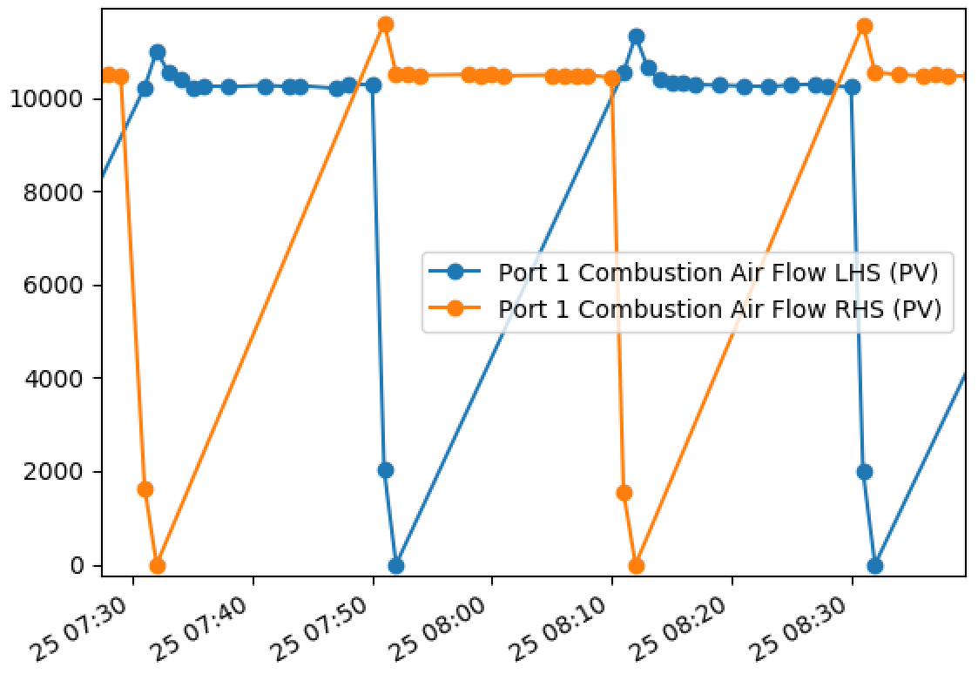
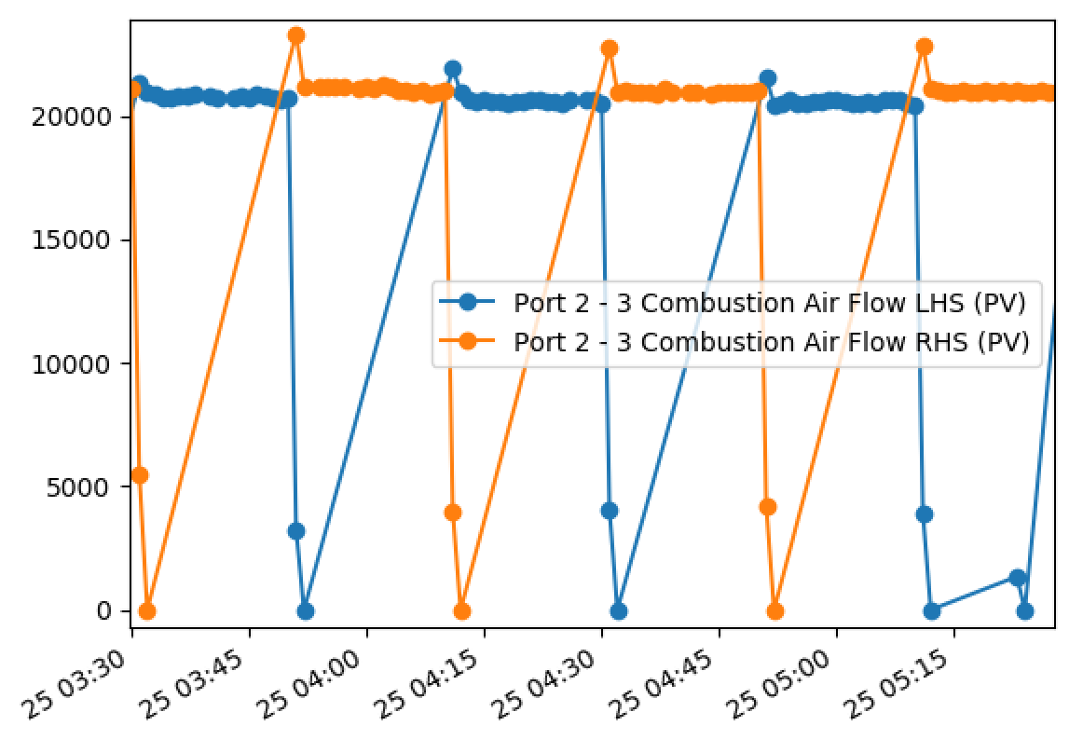
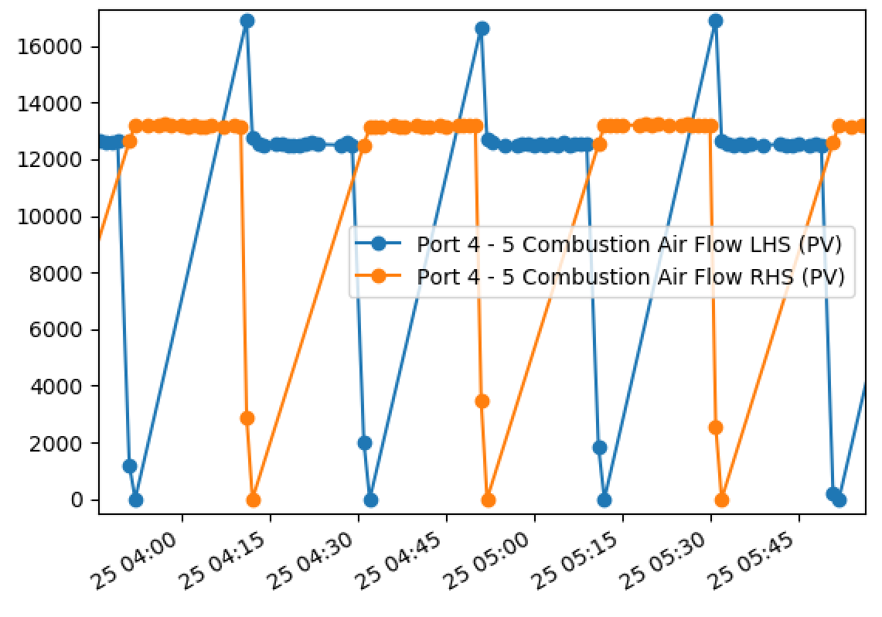
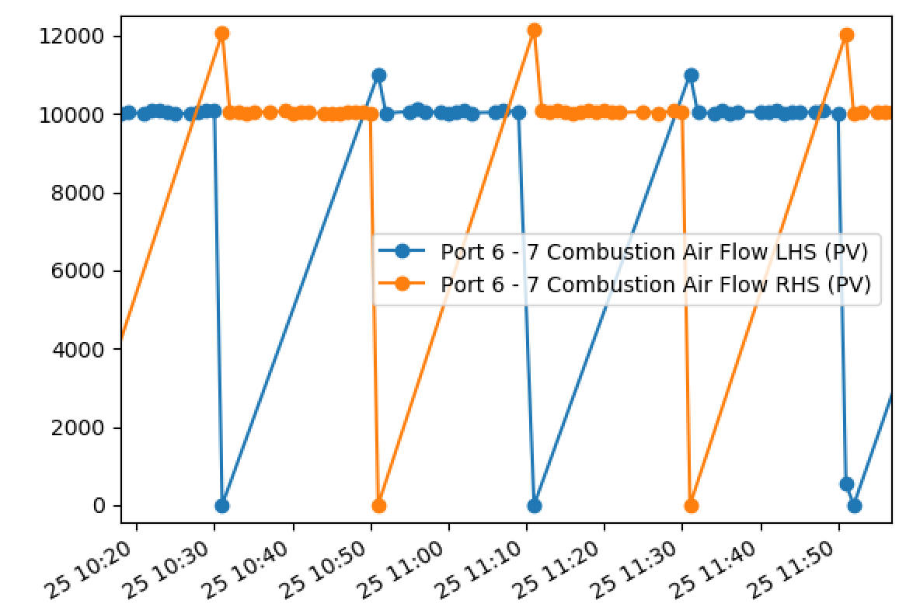
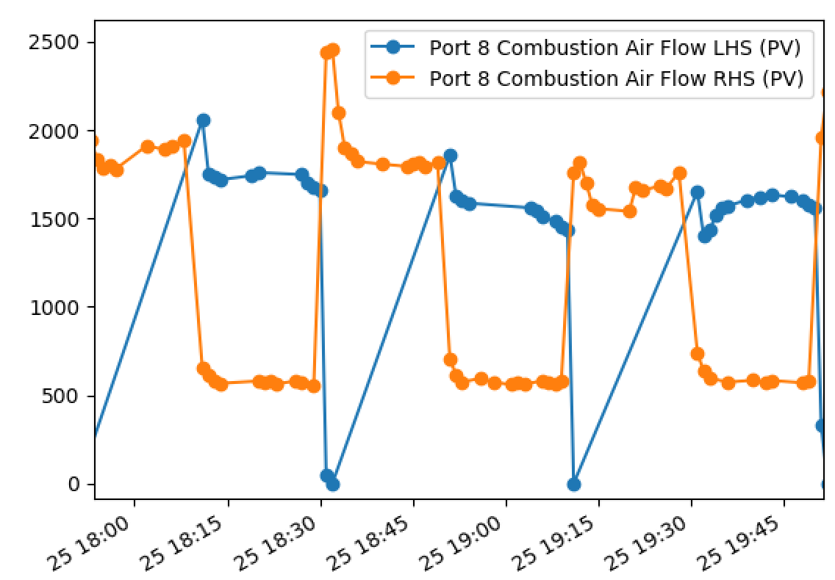
Combinations
These don’t look so difficult to deal with, but not sure what we want to do with these spikes?

Slide 12
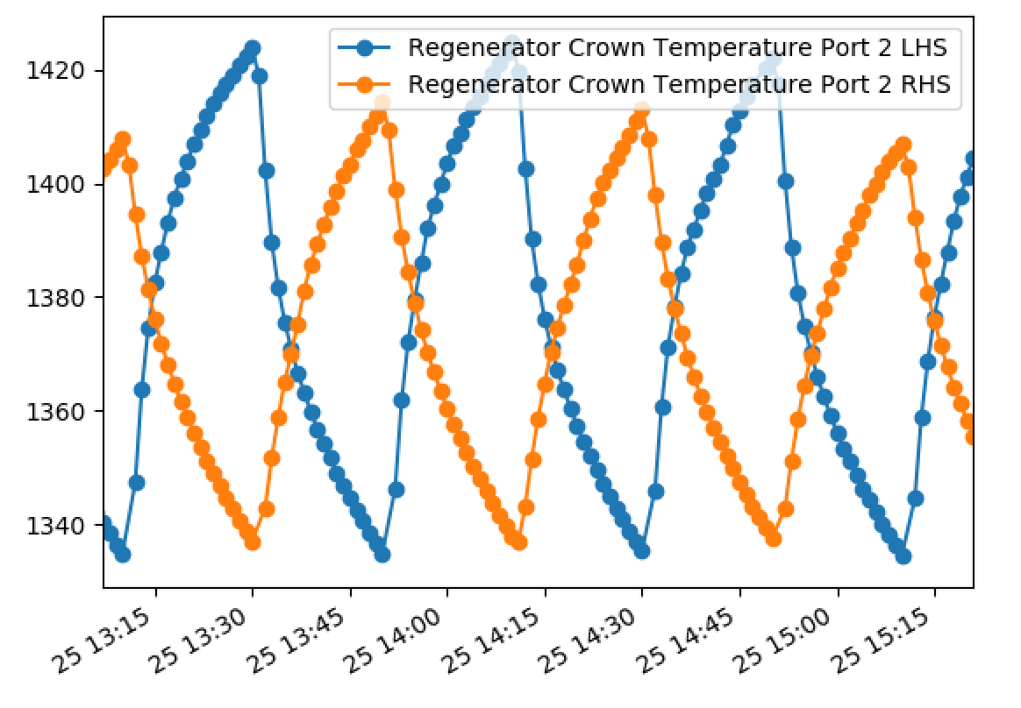
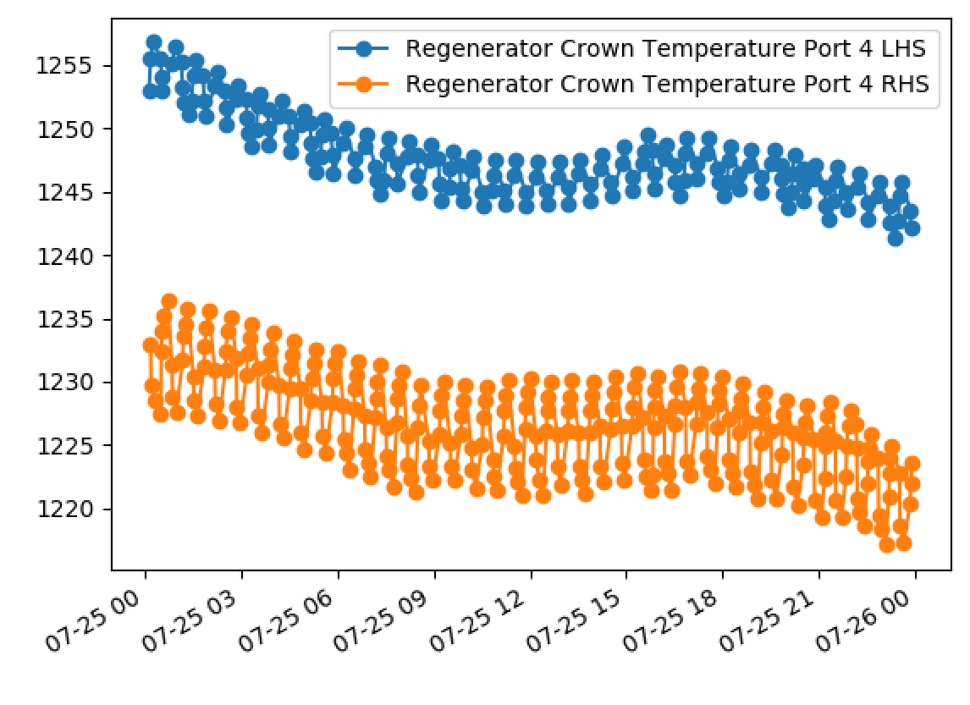
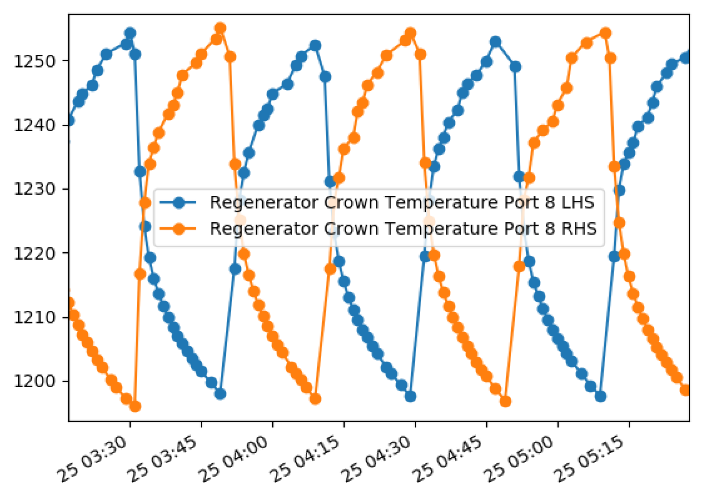
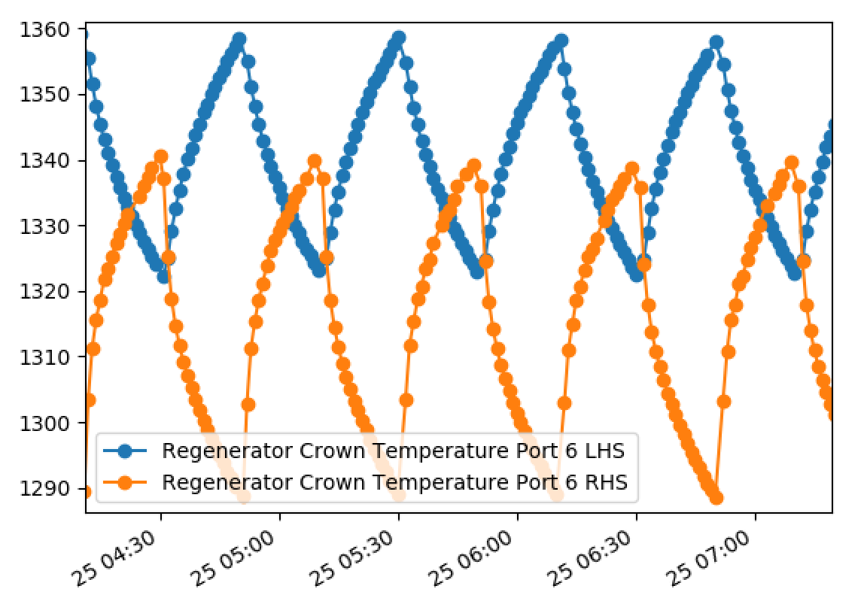
Combinations
Best approach to deal with the regenerator crown temperatures?
In particular, what features do we want to capture from these?

Slide 13
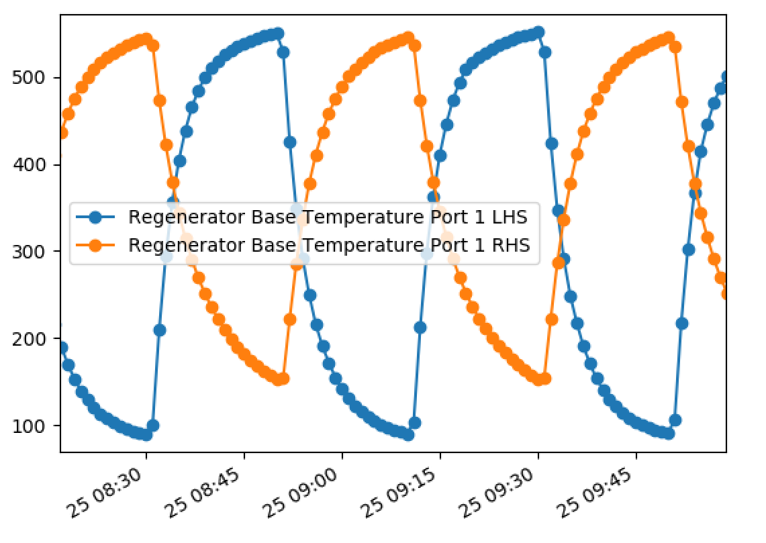
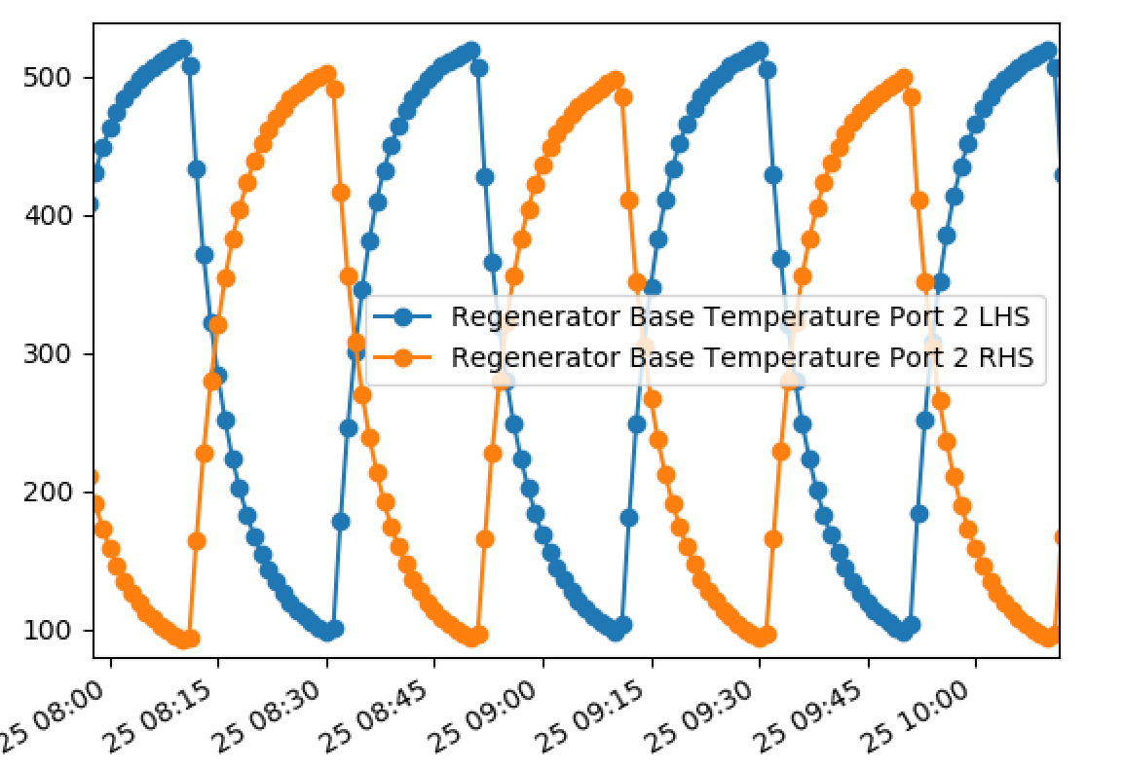
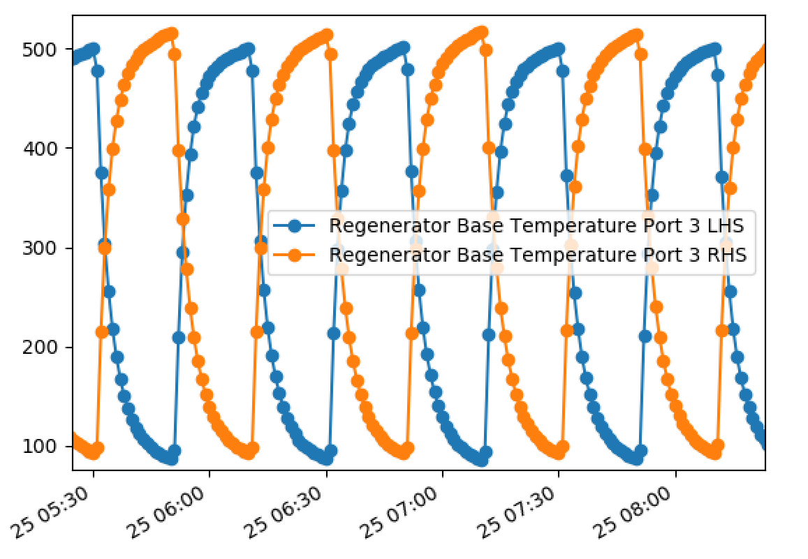
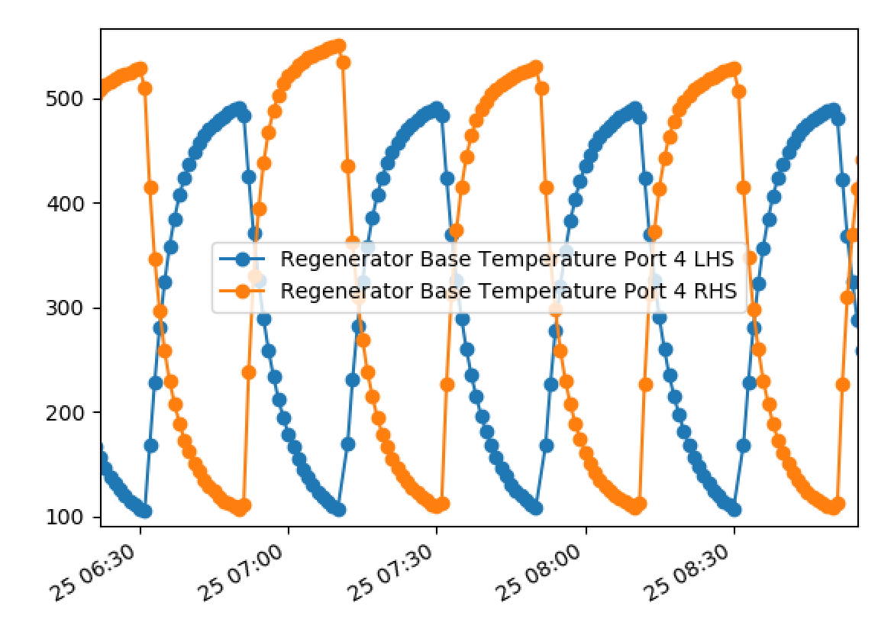
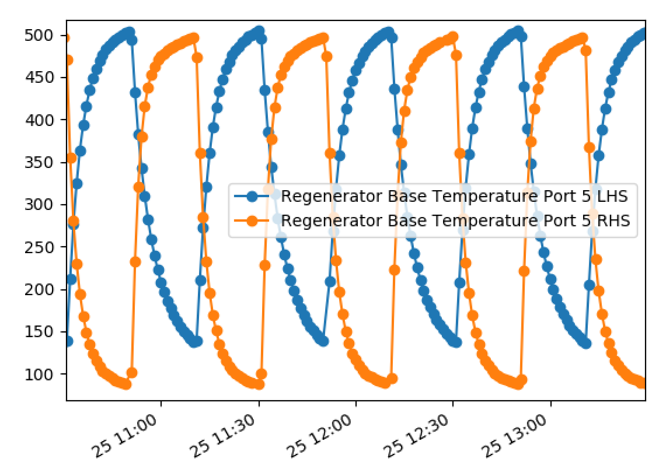
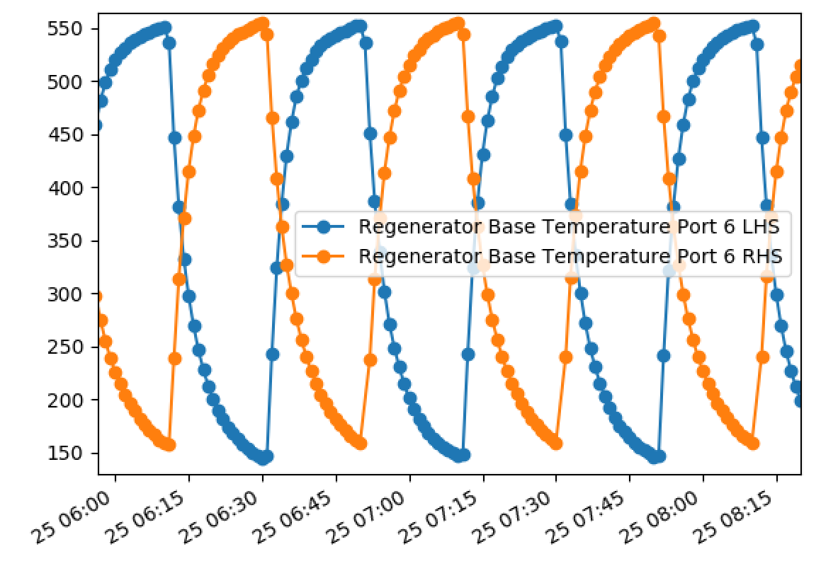
Combinations
Similar question applied to these…

Slide 14
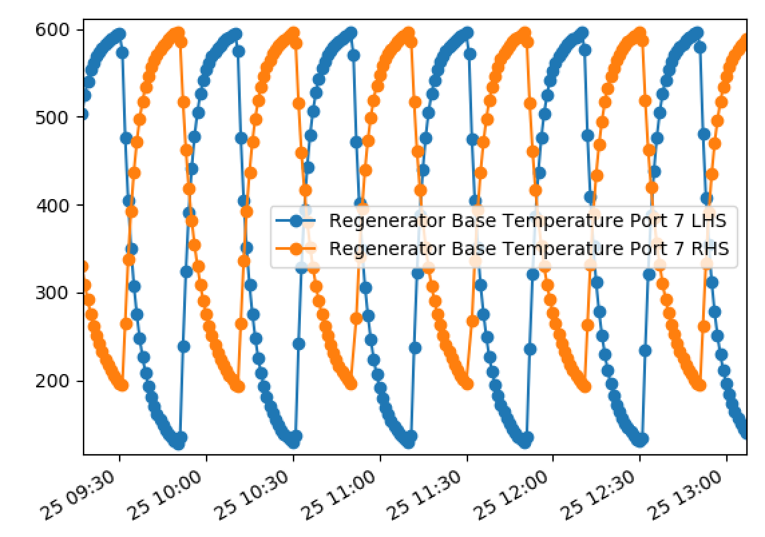
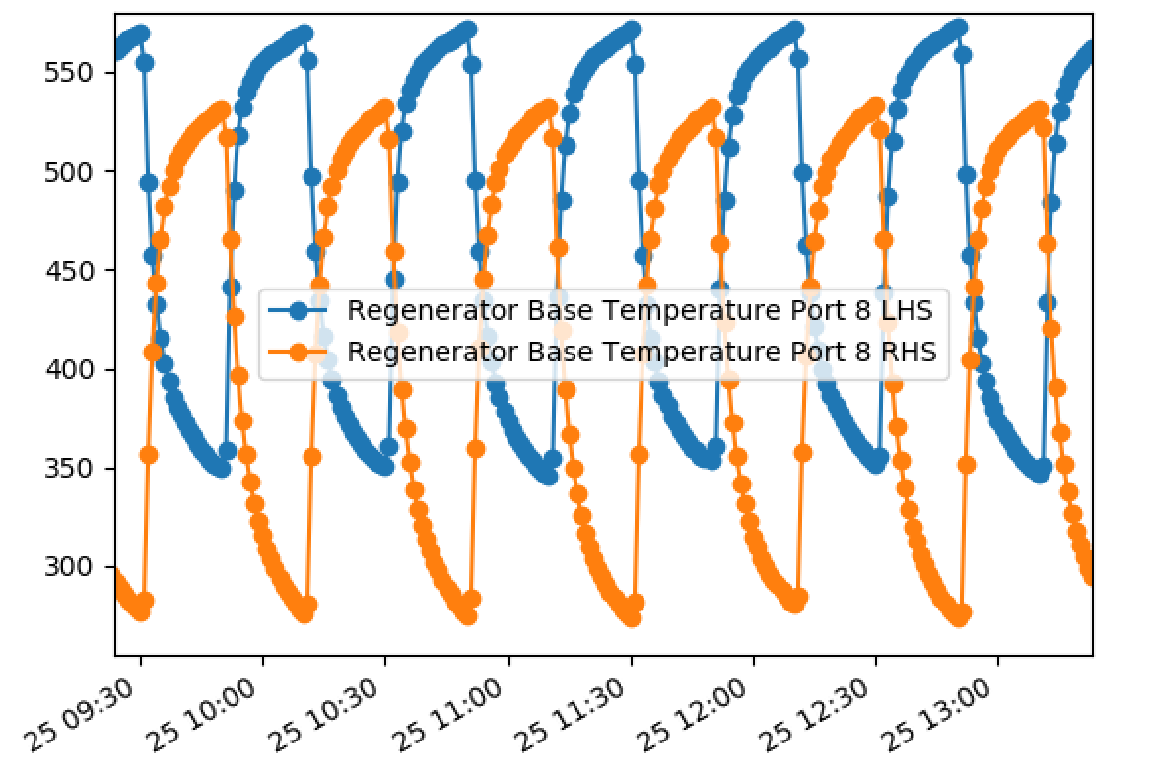
Combinations
Again, what features do we want to capture from these signals?

Slide 15
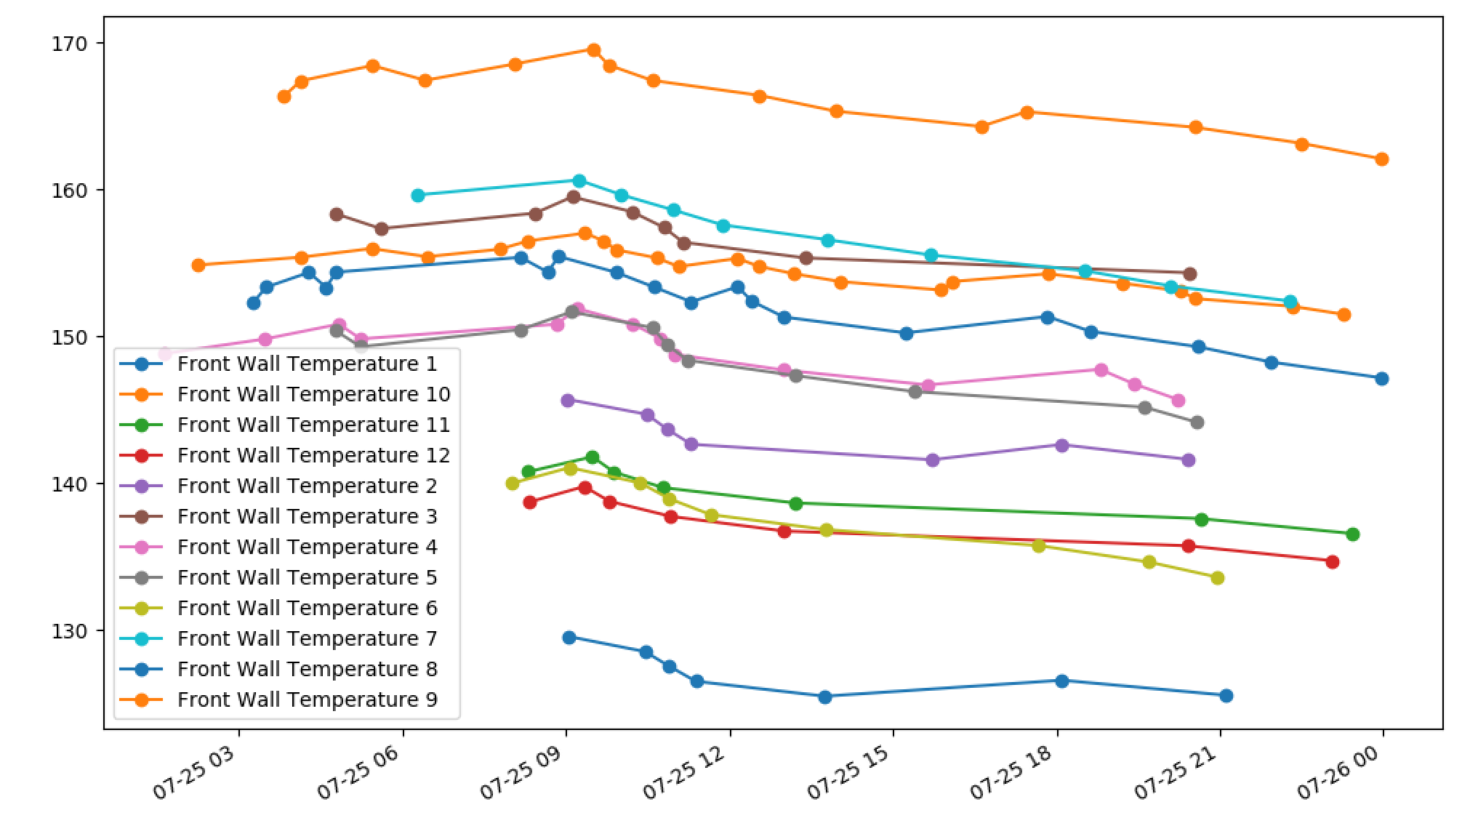
Combinations
It looks like we have missing data here? At the moment we are taking the maximum of the available data; seems sensible?

Slide 16
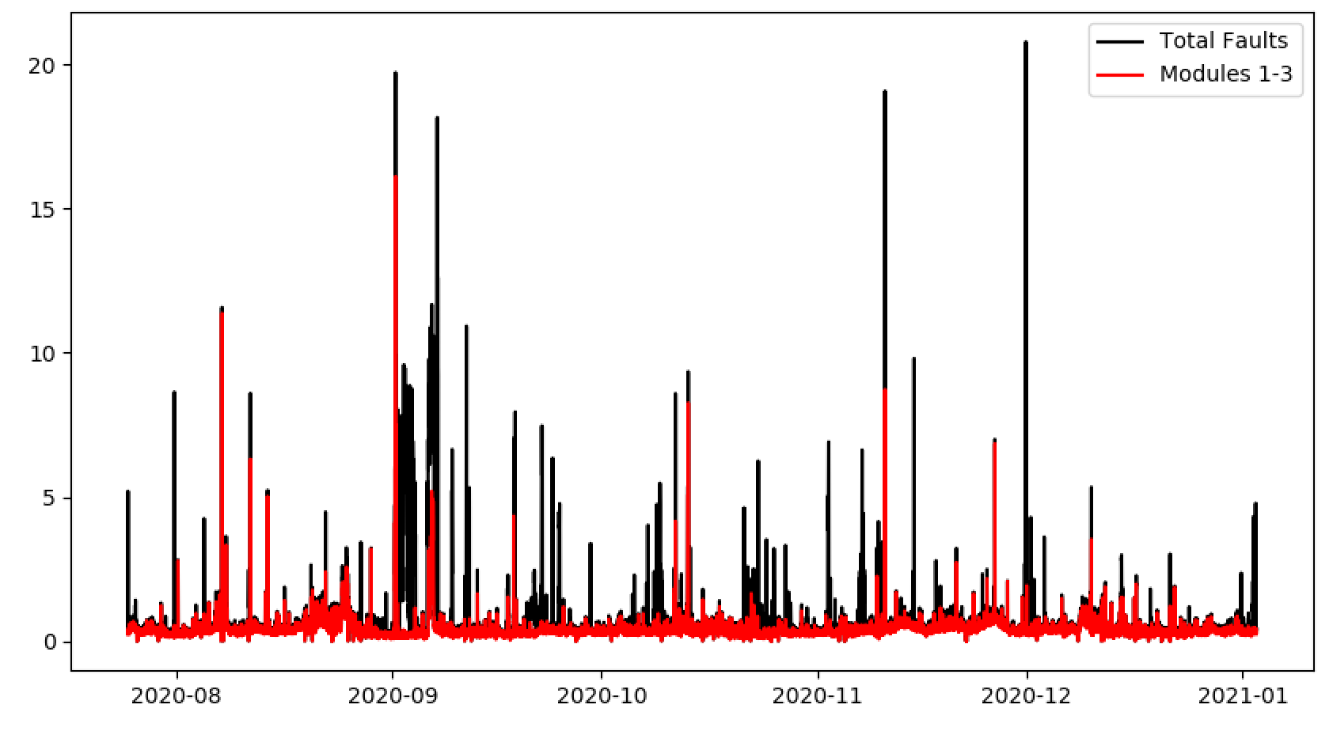
ISRA
Only including modules 1-3 (i.e. removing modules 0 and 4).

Slide 17
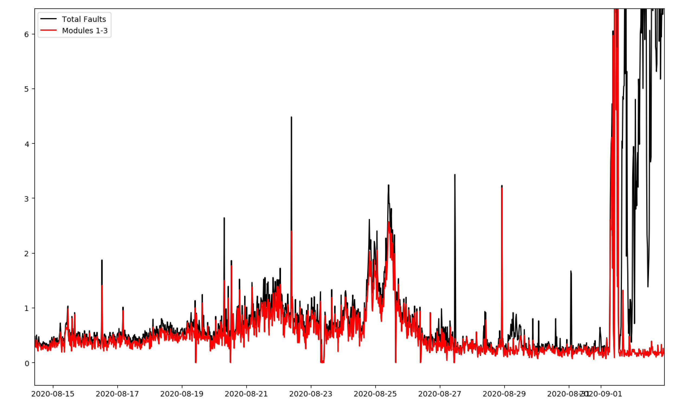
ISRA
Only including modules 1-3 (i.e. removing modules 0 and 4).

Slide 18
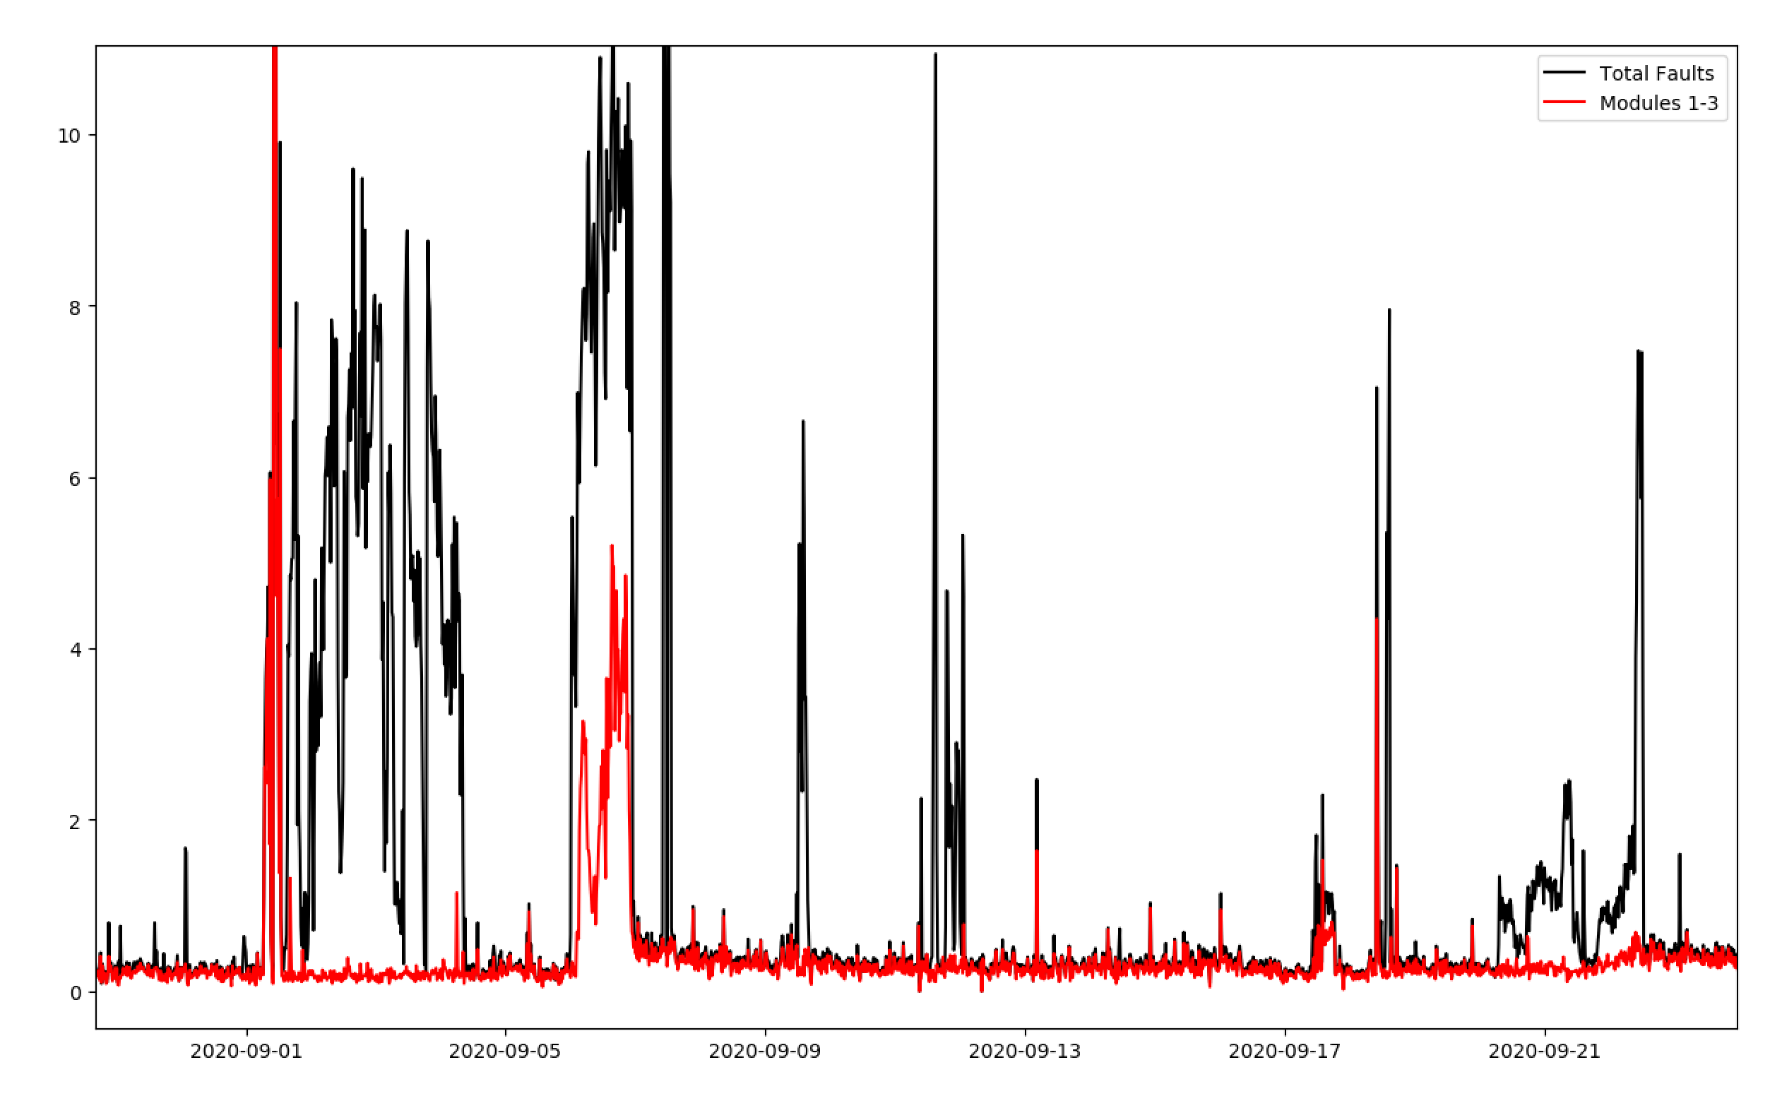
ISRA
Only including modules 1-3 (i.e. removing modules 0 and 4).

Slide 19
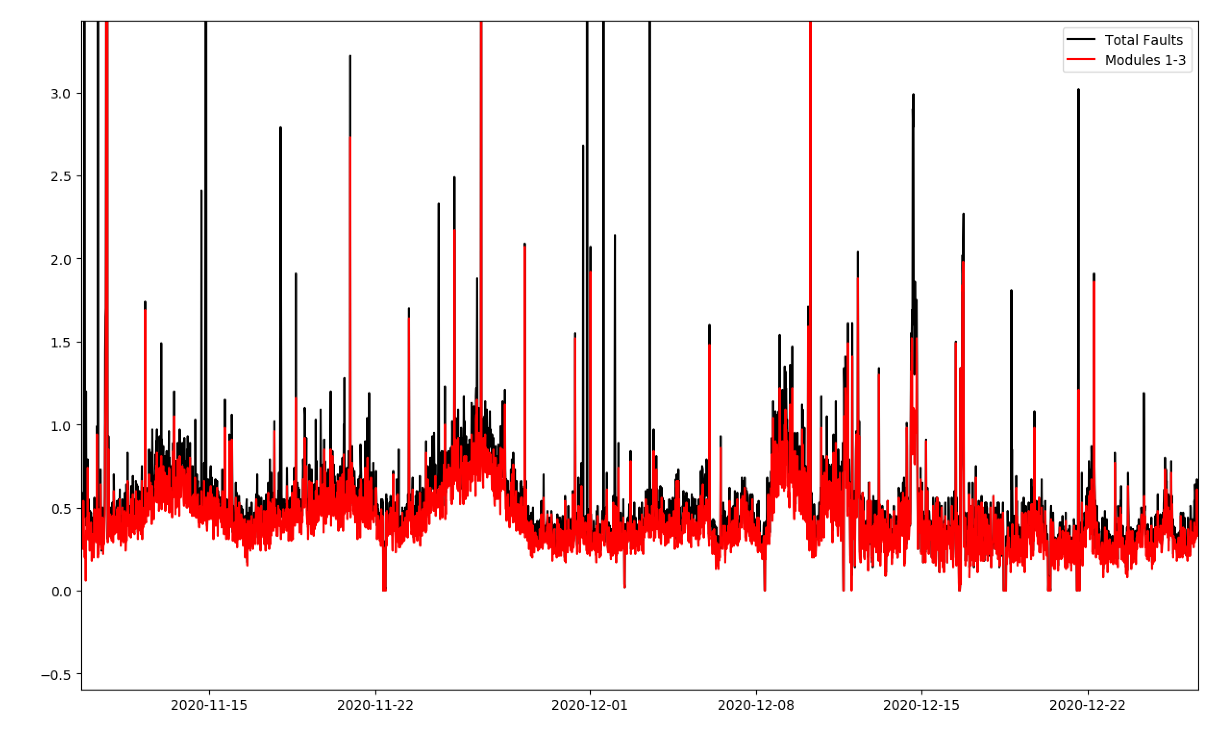
ISRA
Only including modules 1-3 (i.e. removing modules 0 and 4).

Slide 20
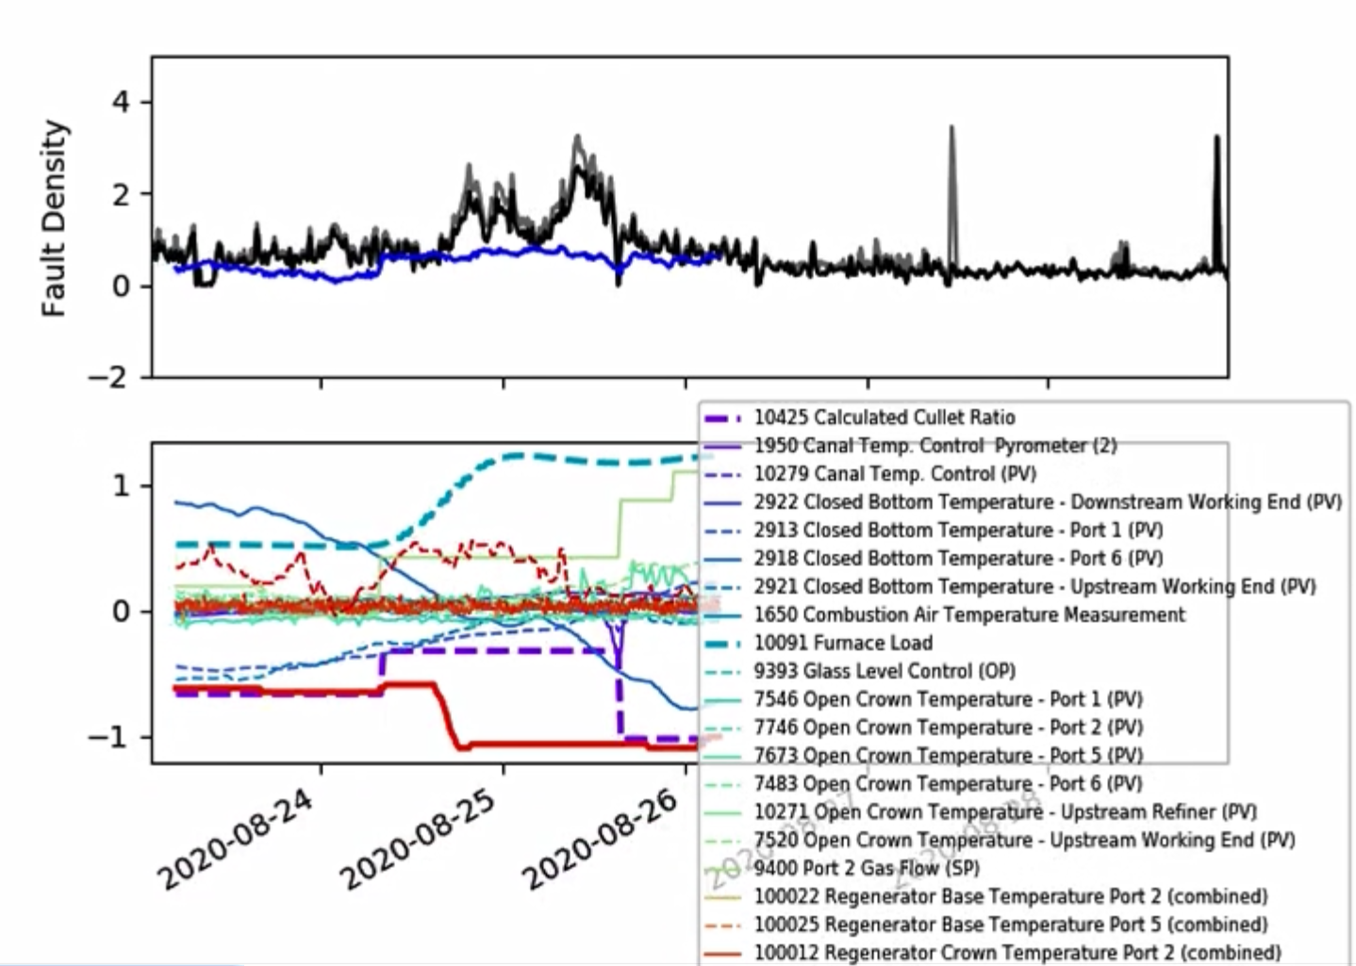
ISRA

Slide 21
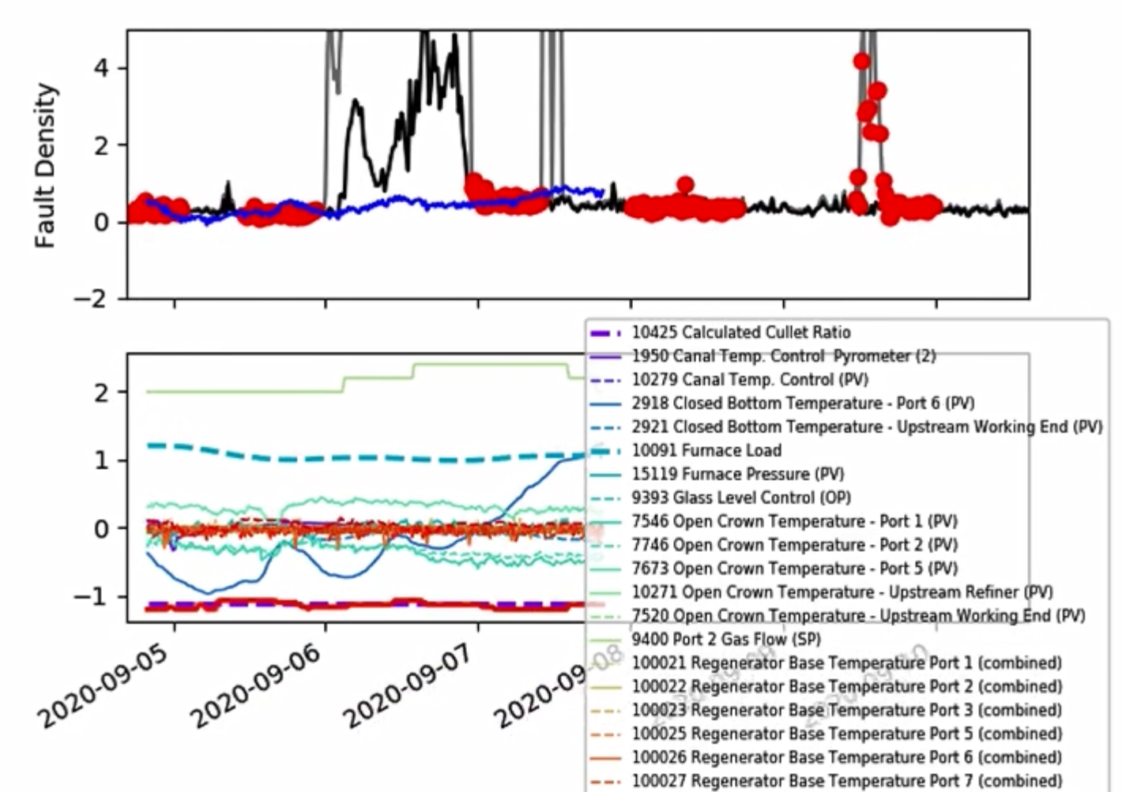
ISRA

Slide 22
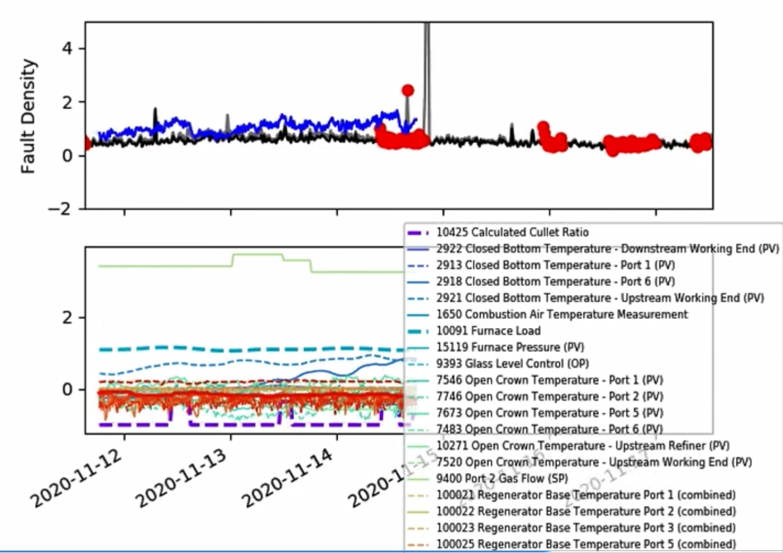
ISRA

Slide 23
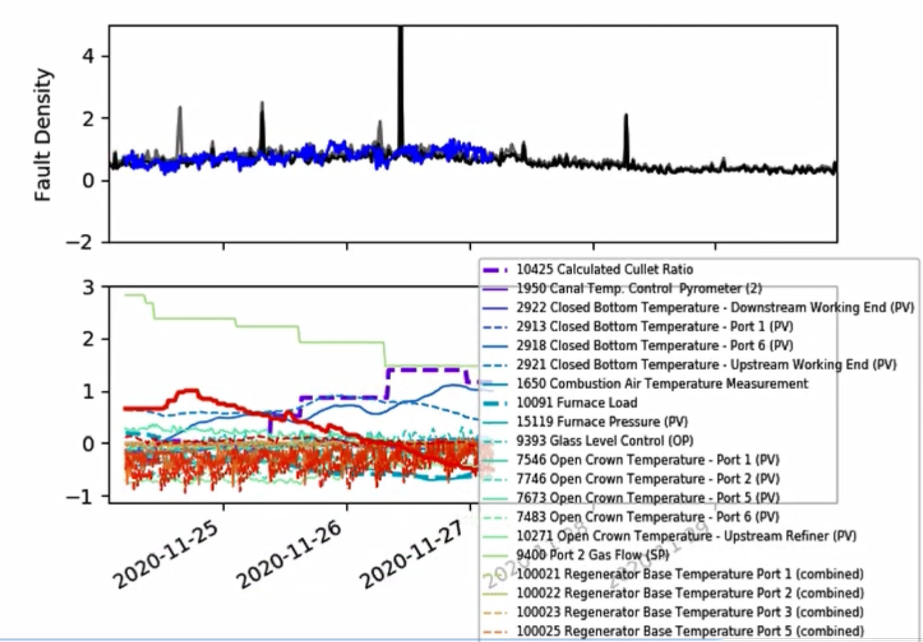
ISRA

Slide 24
Next Steps
Combination signals look to be really important – they appear as significant inputs even when the current pre-processing leaves them with discontinuous jumps.
Would recommend putting the combination signals through a different ‘pipeline’ (although it will mostly use the same basic methods as before – shouldn’t take long but we need to think carefully about what ‘features’ we want to extract from these signals).
Some tighter bounds on the time lags.

Slide 25
Thank you for your attention. ANY QUESTIONS?

